Slide 1


Predicting Customer Churn in the Telecom Industry
This presentation explores the use of predictive analytics to identify and understand the factors that contribute to customer churn in the telecom
industry, enabling businesses to develop effective strategies to retain their valuable customer base.

Slide 2




Introduction
Customer Churn Defined
Importance in Telecom Industry
Factors Influencing Churn
Challenges in Predicting Churn
The phenomenon of customers discontinuing their relationship with a telecom service provider.
Factors such as pricing, customer service, network quality, and competitors' offerings can contribute to customer churn.
High customer churn rates can significantly impact a telecom company's revenue, growth, and profitability.
Accurately predicting customer churn is a complex task due to the dynamic nature of customer behavior and preferences.
Understanding the critical nature of customer churn and the challenges in predicting it is the first step towards developing effective strategies to retain customers and drive business growth in the telecom industry.

Slide 3
Dataset Details
Customer ID
A unique identifier for each customer in the telecom dataset.
Gender
The gender of the customer, either 'Male' or 'Female'.
Age
The age of the customer in years.
Tenure
The number of months the customer has been with the telecom company.
Contract Type
The type of contract the customer has, either 'Month-to-Month', 'One Year', or 'Two Year'.
Monthly Charge
The monthly amount the customer pays for their telecom services.
Total Charges
The total amount the customer has paid over the course of their tenure with the telecom company.
Churn
Whether the customer has churned (left the company) or not, represented as “Yes” or “No”.

Slide 4




Data Preprocessing
Feature Engineering
Data Normalization
Handling Imbalanced Data
Data Cleaning
Train-Test Split
Dropped rows with missing 'TotalCharges', converted the column to numeric, and removed inconsistencies and the unnecessary 'customerID' column to ensure data integrity.
Created dummy variables for categorical features like 'gender', 'Partner', and 'Contract' to ensure proper representation and mitigate bias. Transformed features to enhance predictive power, such as calculating customer tenure and generating binary flags for churn.
Scaled and normalized numerical features such as 'Total Charges' and 'Monthly Charges' to ensure consistent ranges across data, optimizing model performance and effectiveness for machine learning algorithms.
Dividing the dataset into training and testing sets to evaluate the model's performance and prevent overfitting.
Addressing the class imbalance in the dataset, where the number of churned and non-churned customers is significantly different, using SMOTE (Synthetic Minority Over-sampling Technique) to balance the distribution of classes.

Slide 5
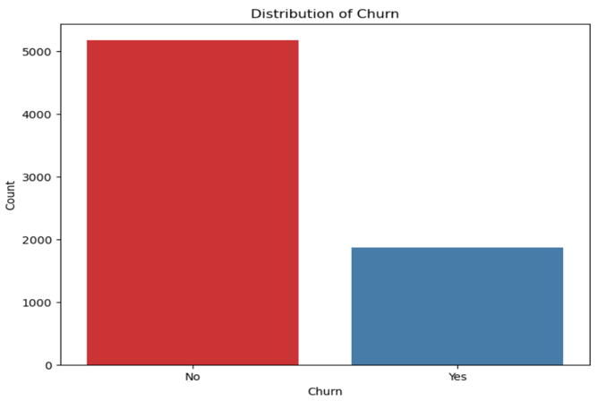
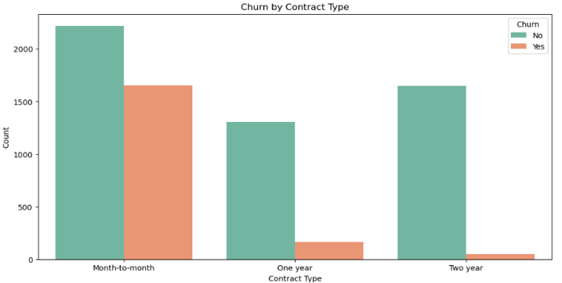
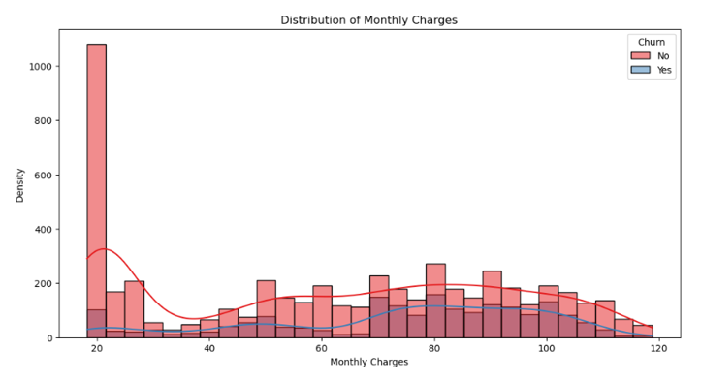
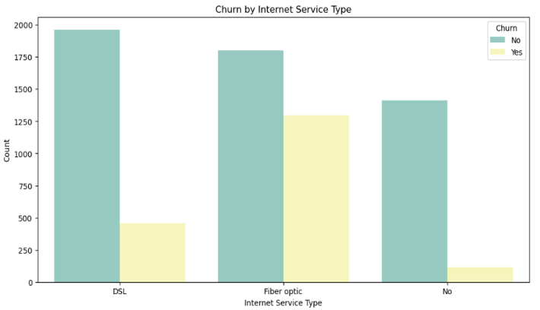
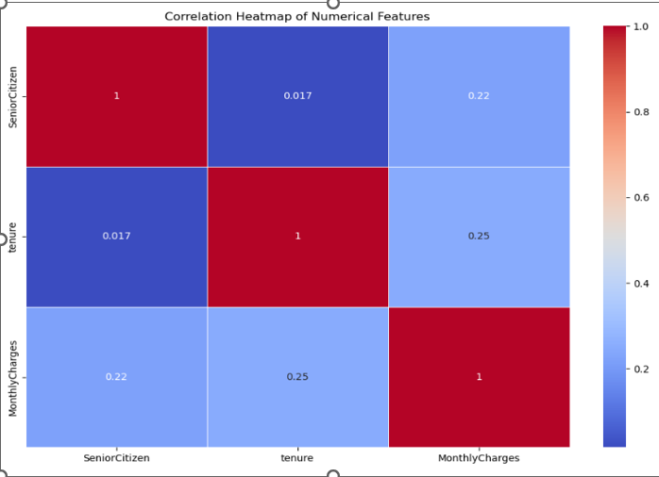
Exploratory Data Analysis
Churn Distribution
Correlation Matrix
Churn by Contract Type
Monthly Charges Distribution
Churn by Internet Service Type
A histogram shows around 5,000 customers who stayed versus about 2,000 who churned, highlighting the imbalance and the need for effective retention strategies.
The heatmap shows weak correlations between numerical features. The highest correlation, 0.25, between tenure and monthly charges suggests limited predictive strength.
A bar chart shows Customers on month-to-month contracts churn more than those on longer-term contracts. Encouraging longer commitments could improve retention rates.
Customer churn shows no clear pattern with monthly charges, suggesting other factors influence churn.
A bar chart clearly shows that DSL customers experience higher churn rates compared to Fiber Optic customers. This insight suggests a need for targeted retention strategies.

Slide 6
Model Building
Logistic Regression
Random Forest
Gradient Boosting
A linear classification model is used to predict the probability of a binary outcome. Suitable for modeling customer churn as a yes/no decision.
An ensemble method that combines multiple decision trees to improve accuracy and reduce overfitting. Effective for handling non-linear relationships in customer churn data.
Another ensemble method that iteratively builds weak prediction models and combines them to create a strong predictive model. Powerful for capturing complex patterns in customer churn.
Model Evaluation
Model Selection
Metrics like accuracy, precision, recall, and F1-score will be used to assess the performance of the machine learning models on the customer churn prediction task.
The best-performing model will be selected based on the evaluation metrics and deployed to predict customer churn in the telecom industry.

Slide 7
Model Evaluation Before Hyperparameter Tuning
Model | Accuracy Score
Logistic Regression Model | 78.5%
Random Forest Classifier | 77.8%
Gradient Boosting Classifier | 78.9%
Model
Accuracy

Slide 8
Model Evaluation After Hyperparameter Tuning
Model | Accuracy Score
Logistic Regression Model | Before hyperparameter tuning, Logistic Regression achieved 78.54% accuracy, which improved to 80.94% after tuning.
Random Forest Classifier | Before hyperparameter tuning, Random Forest Classifier achieved 77.75% accuracy, which improved to 80.64% after tuning.
Gradient Boosting Classifier | Before hyperparameter tuning, the Gradient Boosting Classifier achieved 78.89% accuracy, which improved to 80.50% after tuning.
Model
Accuracy

Slide 9



Conclusion
Optimal Model Selected
Deployment Recommendations
Future Enhancements
The Random Forest Classifier was selected as the optimal model for predicting customer churn with an accuracy of 80.5%
The model should be integrated into the company's customer relationship management (CRM) system to proactively identify and retain high-risk customers
Additional data sources, such as customer sentiment and social media activity, can be incorporated to further improve the model's predictive power
The optimal Random Forest Classifier model can be effectively deployed to predict and mitigate customer churn in the telecom industry, and ongoing enhancements to the model can lead to even better performance.

Slide 10
Challenges and Opportunities
Data Quality
Class Imbalance
Model Scalability
Ensuring the accuracy, completeness, and consistency of customer data is crucial for building effective predictive models. Addressing issues like missing values, outliers, and data irregularities is a key challenge.
Telecom customer churn data often exhibits a significant class imbalance, with a much larger proportion of non-churning customers compared to churning customers. This can lead to biased models and poor performance on the minority class.
As the telecom customer base grows, scaling the predictive models to handle the increasing data volume and complexity is a critical challenge. Ensuring the models can be trained and deployed efficiently is crucial.
Customer Segmentation
Personalized Marketing Campaigns
Identifying distinct customer segments based on their behavior, demographics, and preferences presents an opportunity to develop more personalized and targeted marketing campaigns to reduce churn.
Leveraging the insights from the predictive models, telecom companies can design and deploy personalized marketing campaigns tailored to the specific needs and preferences of individual customers, increasing the effectiveness of customer retention efforts.

Slide 11

Ethical Considerations
Developing a churn prediction model raises ethical considerations that must be carefully addressed. Ethical concerns include ensuring the model does not exhibit biases or discriminate against certain customer segments, preserving customer privacy and data security, and considering the potential impacts of the model's predictions on vulnerable individuals or communities.

Slide 12





Incorporate Customer Sentiment Analysis
Enhance Feature Engineering with Geospatial Data
Future Enhancements
Leverage Ensemble Modeling Techniques
Improve Real-Time Churn Prediction Capabilities

